Slide 1

GitHub Copilot
Dev Days
Hyderabad
April 18, 2026
Satya K
Lead Engineer, Dhan AI

Slide 2


“Hey Copilot! Build a SaaS app that makes millions…”
“Hi AI, build me a startup
Make it scalable,
Make it viral,
Make me rich”
Creativity ≠ AI’s job
Idea ownership must stay with you
“If AI gives you the idea…don’t be surprised if it also gives the same idea to 10,000 other people.”

Slide 3
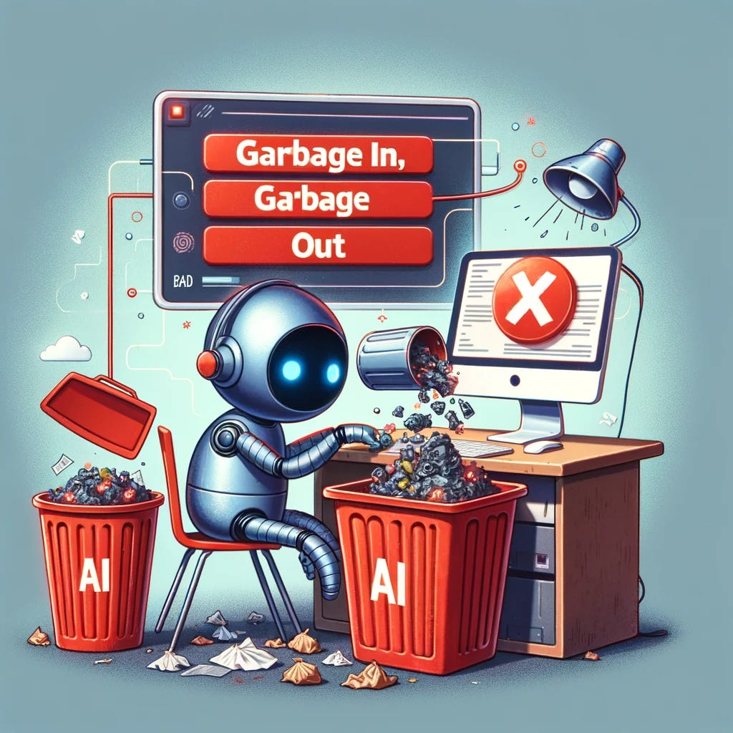
Prompt → Fail → Prompt → Fail → Existential Crisis
Prompt after prompt loop
Prompt 1 → “Not working”
Prompt 2 → “Still broken”
Prompt 5 → “Now worse”
Prompt 10 → “What am I even building?”
You’re not building a product…you’re negotiating with AI.
No research, No plan, Just blind iteration
Notes:
“This is the real workflow most people follow…”
“You’re not building a product…
you’re negotiating with AI.”

Slide 4
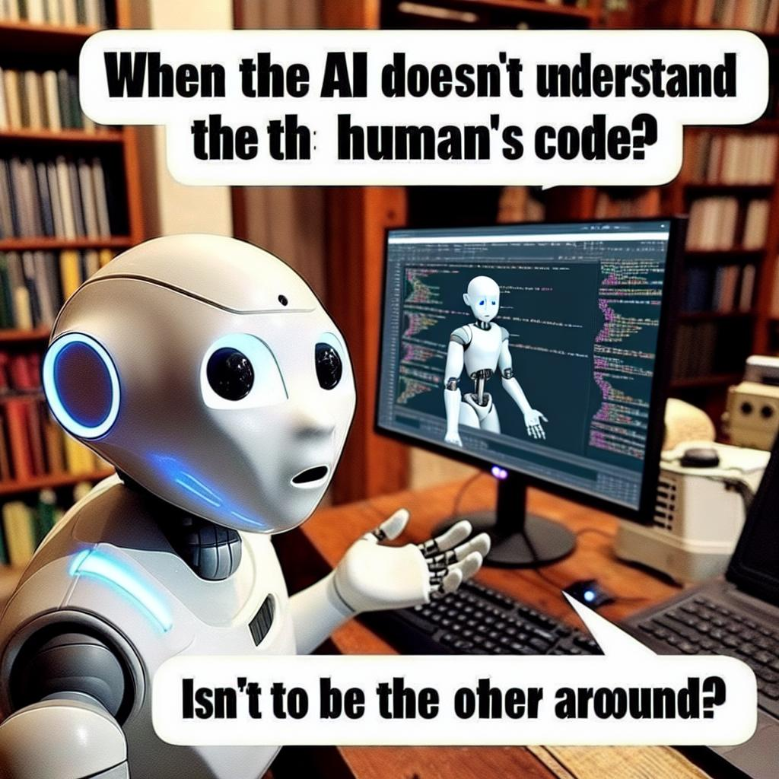
AI Is Only As Good As The Instructions You Give
Don’t let AI decide everything
No context
No constraints
No architecture
Expecting magic
Agents need:
  Tools,
  Skills,
  Context,
  Constraints,
  Clear responsibilities
Notes:
“AI doesn’t think long-term…”
“It thinks: ‘What’s the fastest way to make this work right now?’”
“AI will help you build something that works…and hackers will help you regret it.”
If your agent has no tools… no structure… congratulations you hired an intern and gave them production access.”

Slide 5
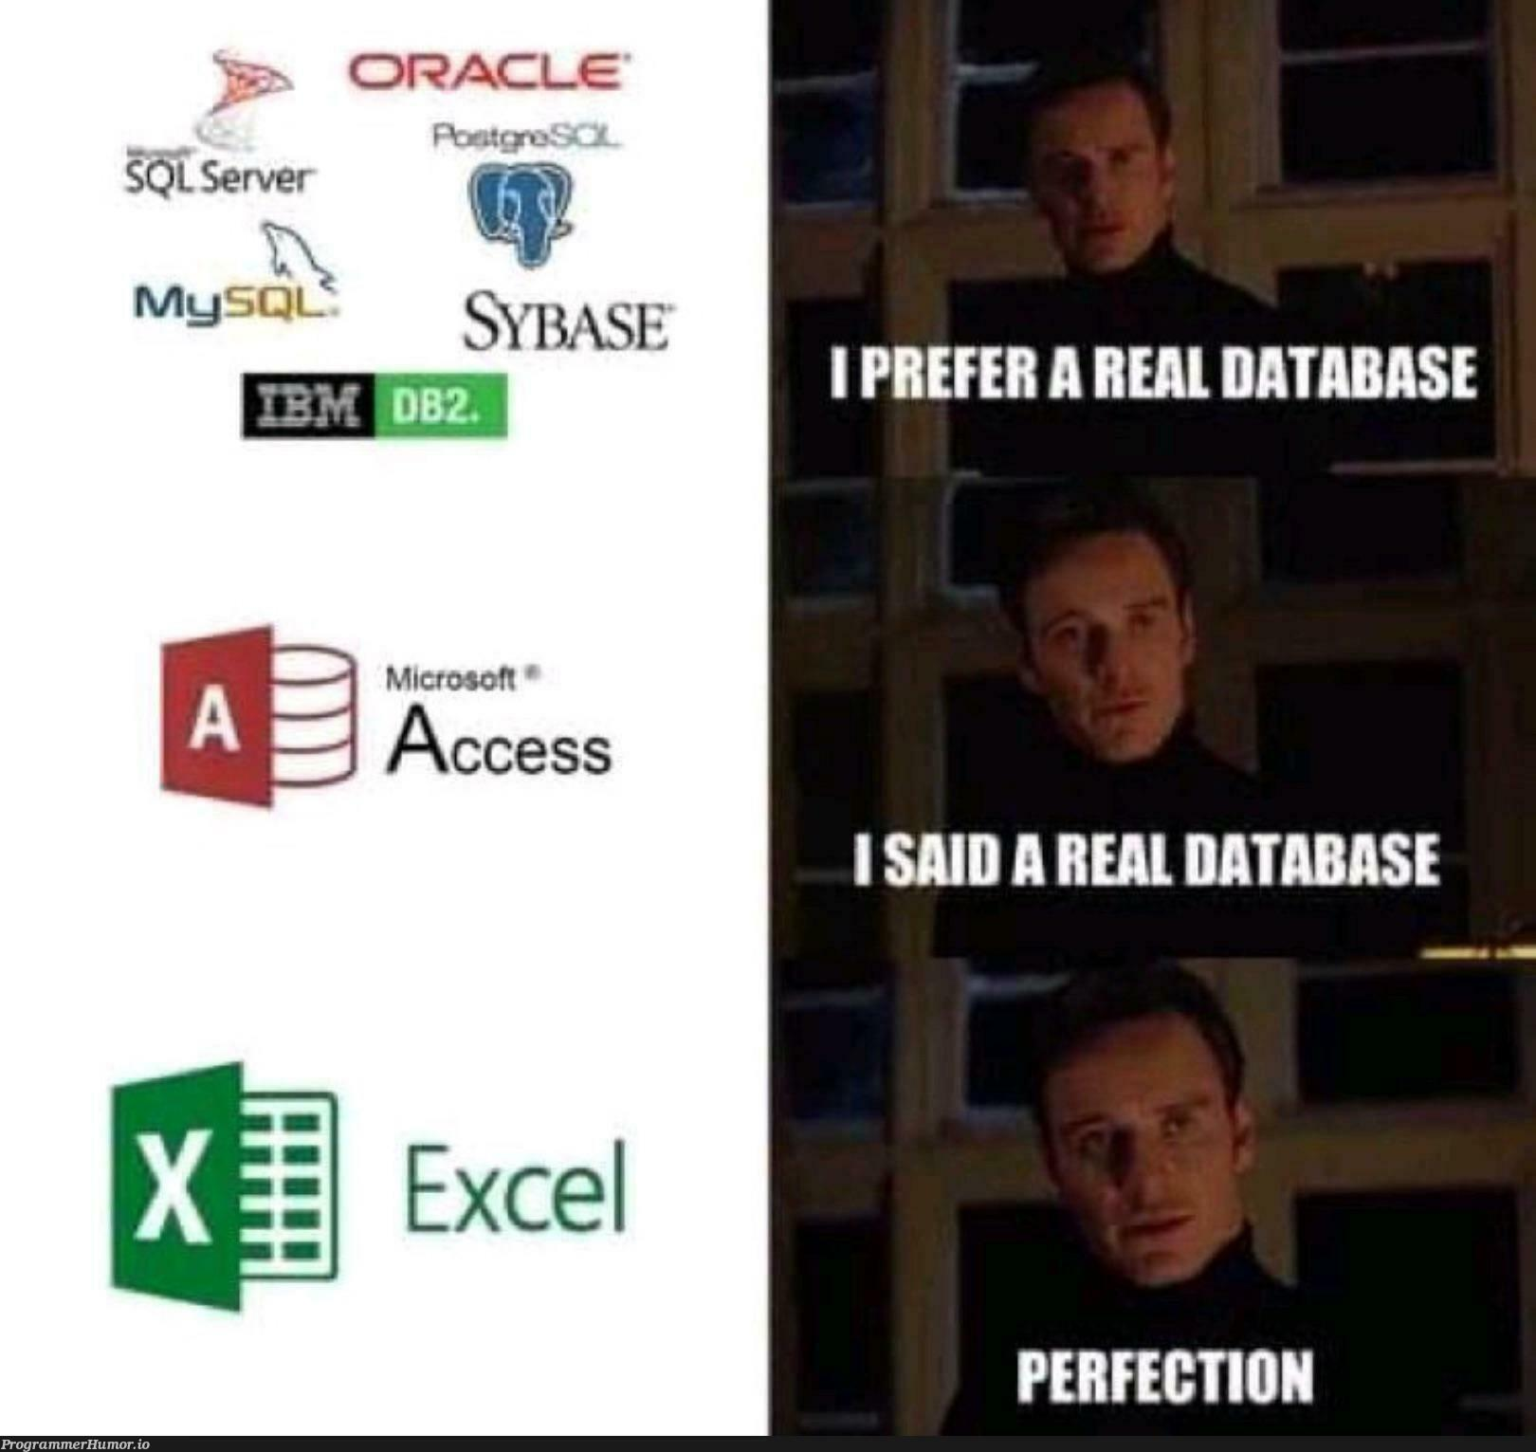
AI Will Choose Easy… Not Correct”
You orchestrate, Let AI work
“Store everything in Google Sheets”
“Push tokens & .env to GitHub”
“Skip security”
“Ship fast 😎”
If you don’t guide AI…it will optimize for shortcuts, not systems
Notes:
“AI is like an intern…”Pause.“A very fast intern…slightly overconfident…and will absolutely do the wrong thing confidently.”
“You didn’t give it skills…
you gave it vibes.”

Slide 6
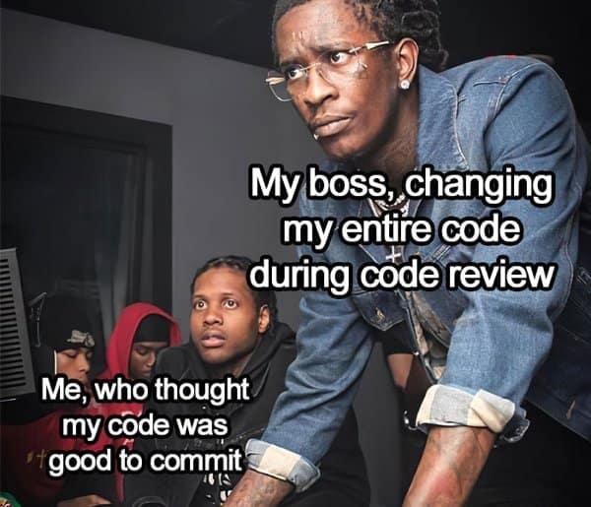
Before VS Code… Open a Conversation
Don’t rush to start coding,
What most people do:
  Jump straight into coding
  Start prompting blindly
  Hope AI “figures it out”
What we should do instead:
Clearly explain the full product idea to AI first
Ask AI to act as:
  Technical Architect/Product
  Explicitly instruct: “No bias, no sugar-coating, act like a critic”
What to ask AI:
  What is missing in this idea?
  What assumptions am I making?
  What should be the scope of V1?
Notes:
“Instead of coding… we start with a design discussion.”
“You are not asking AI to build…
you are asking AI to challenge your thinking.”

Slide 7

Stop Prompting. Start Executing a System.
From Chaos → Controlled Execution
Give AI a system, not questions:
PRD + TRD as context
Instructions.md as rules
Required Skills and supporting agents
Follow a flow:
  Brainstorm → Research → Plan → Execute
Always: Test before moving forward
Commit only working code
Perfect Plan makes it as perfect app
Notes:
“Earlier… we were just throwing prompts at AI and hoping something works.”
“Now… we give AI a clear system to execute.”
“Don’t ask AI ‘what should I do next?’
Tell it ‘this is the plan — execute step 3.’”
“The biggest shift is this…”
“You are no longer prompting randomly…”
“You are running a development pipeline with AI.”

Slide 8

Development Workflow
Idea
Brainstorming
(Refine idea, explore options, create design doc)
Code review
(Spec Compliance and code quality)
Approved?
Setup
(Git Setup, New branch clean test baseline)
Test
Execution
(Parallel/Subagents / Batches), Task execution with reviews)
Planning
(Writing Plans, break into small tasks, verification)
Commit
Next task
Notes:
“Earlier loop: panic
Current loop: progress”
“This workflow looks longer… But this is the shortest path to something that actually works.”

Slide 9


Demo
GitHub Copilot Dev Days
Copilot, Lets Cook
Notes:
“You didn’t learn a tool today…”
“You learned how to think with AI.”
“Don’t ask AI to think for you…
make AI execute your thinking.”
“Next time you open ChatGPT…”, “Don’t say ‘build this for me’…”
“Say… ‘here’s the system — let’s execute it.’”

Slide 10
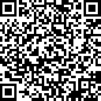
GitHub Copilot Dev Days Sweepstake
All completed surveys are eligible for our sweepstakes to win a GitHub Copilot Pro+ one-year subscription.
https://aka.ms/githubcopilotdevdays/sweepstakes

Slide 11
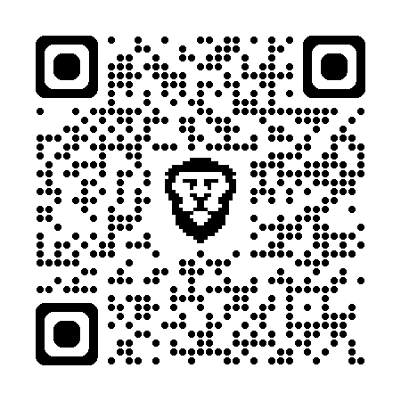
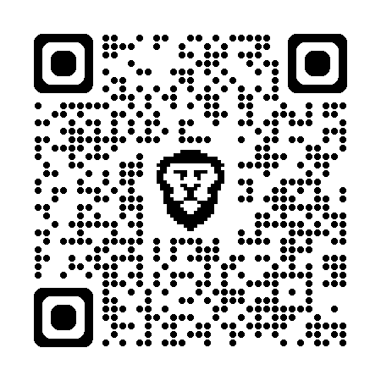
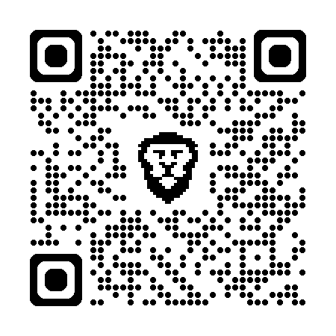
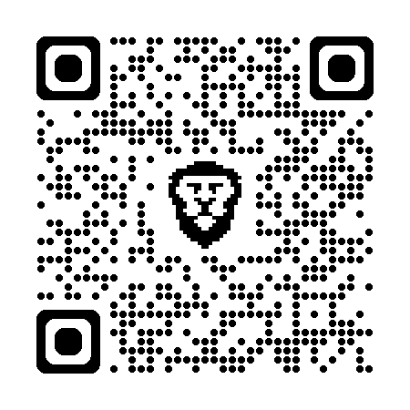
Connect with me
@SriSatyaLokesh
LinkedIn
for quick doubts
GitHub
For projects
Portfolio
to know more
theProFile
to build your website

Slide 12
Thank you
Notes:
alright let's open it up for Q&A

